Slide 1
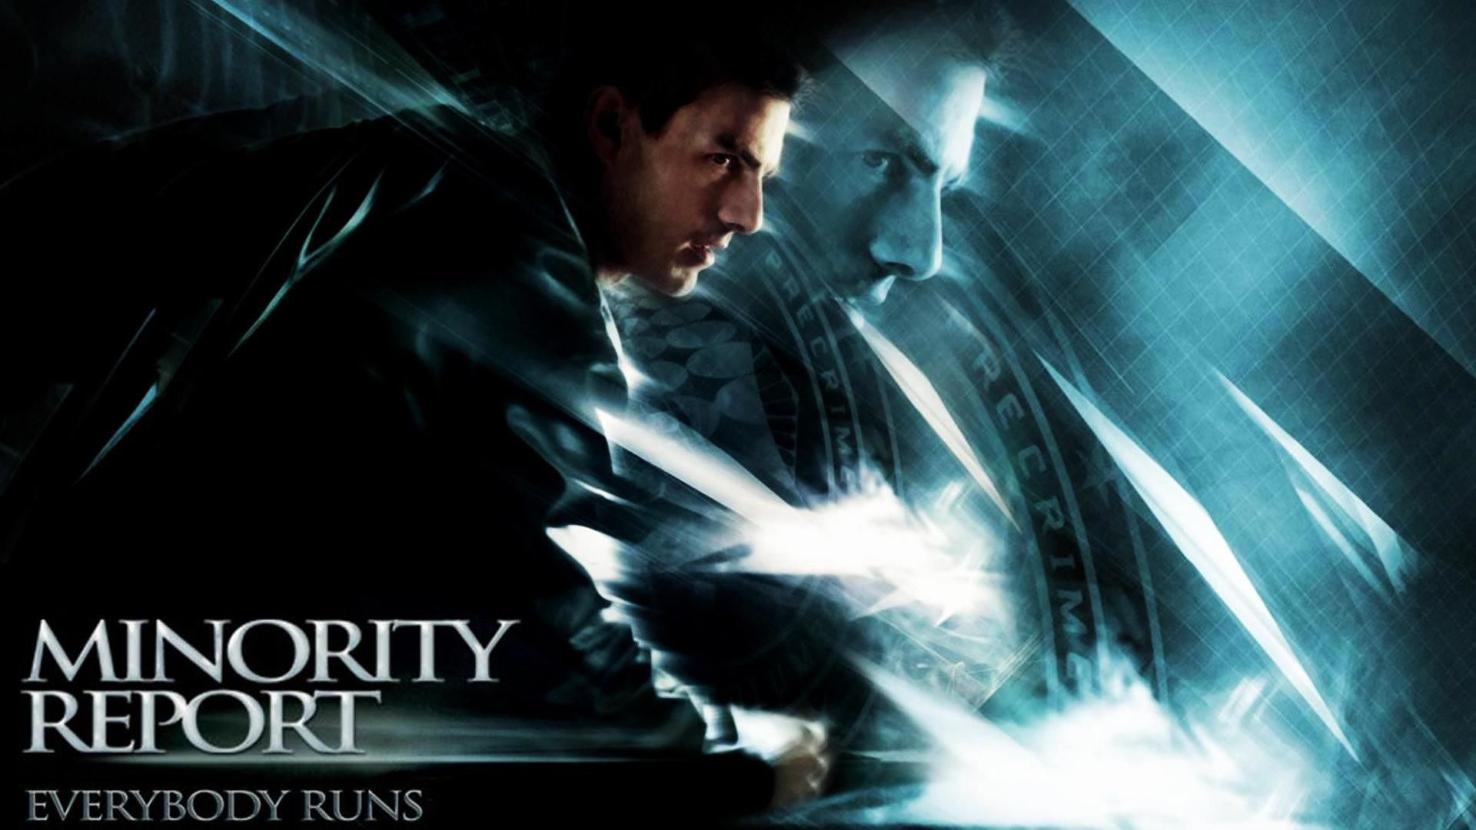
Sci-Fi Movies & HCI Abu Saleh Md Noman

Slide 2
Minority Report (2002)
In the year 2054 A.D. crime is virtually eliminated from Washington D.C. thanks to an elite law enforcing squad "Precrime". They use three gifted humans (called "Pre-Cogs") with special powers to see into the future and predict crimes beforehand. John Anderton heads Precrime and believes the system's flawlessness steadfastly. However one day the Pre-Cogs predict that Anderton will commit a murder himself in the next 36 hours. Worse, Anderton doesn't even know the victim. He decides to get to the mystery's core by finding out the 'minority report' which means the prediction of the female Pre-Cog Agatha that "might" tell a different story and prove Anderton innocent.

Slide 3
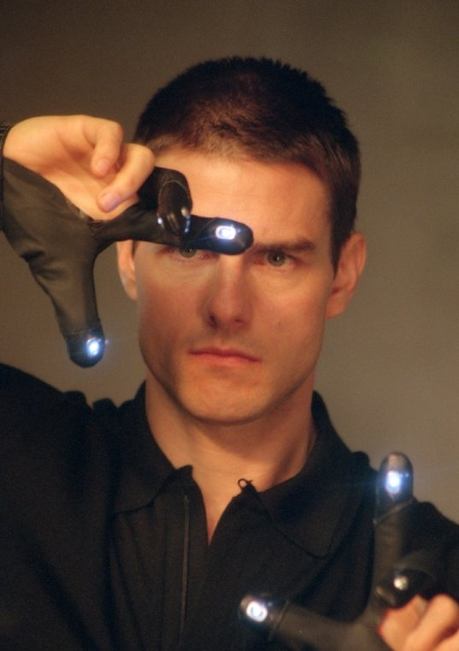
Hand Gesture Gloves

Slide 4
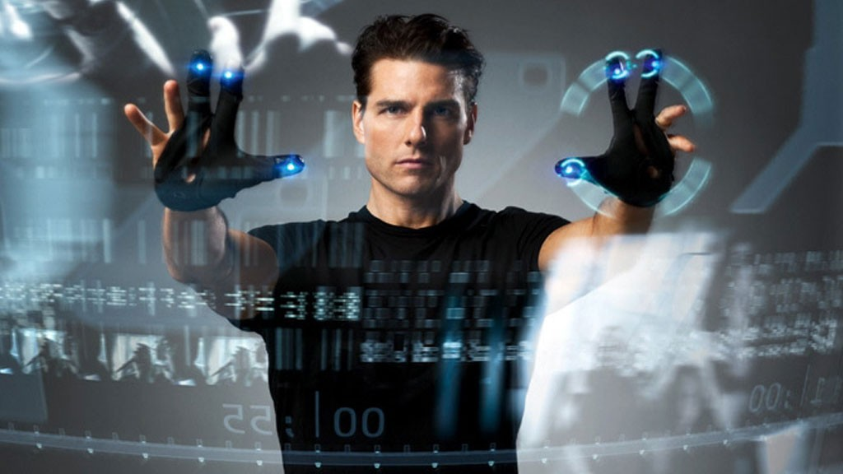
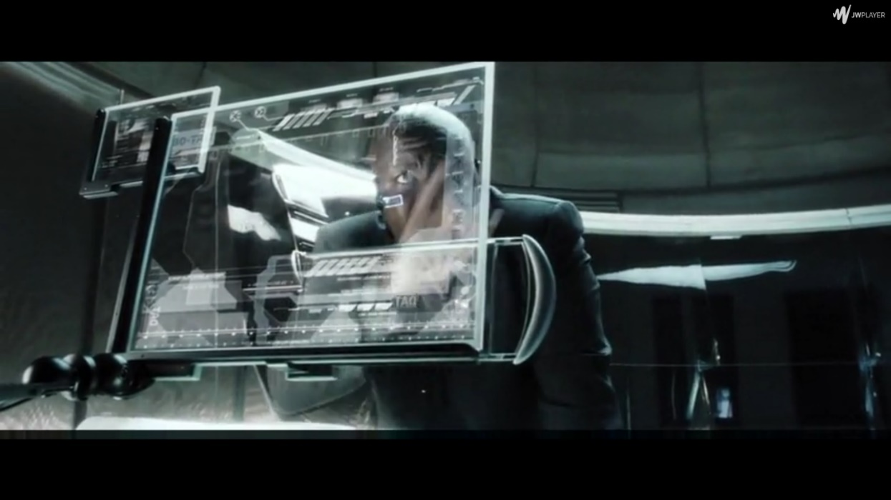
Transparent Display

Slide 5
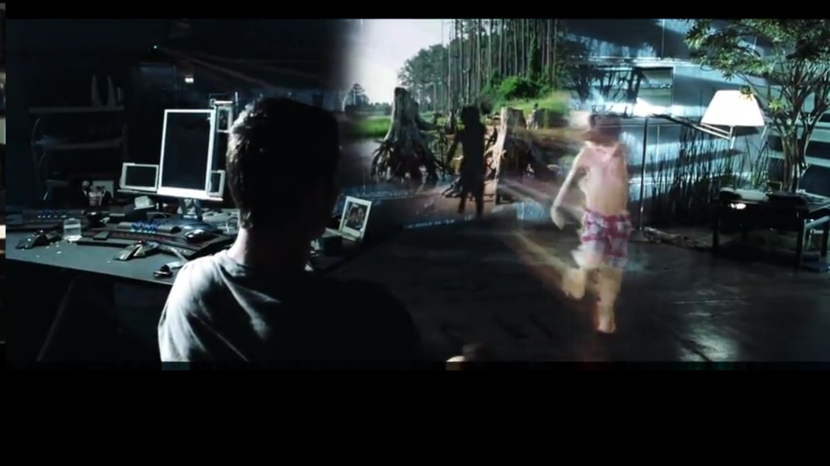
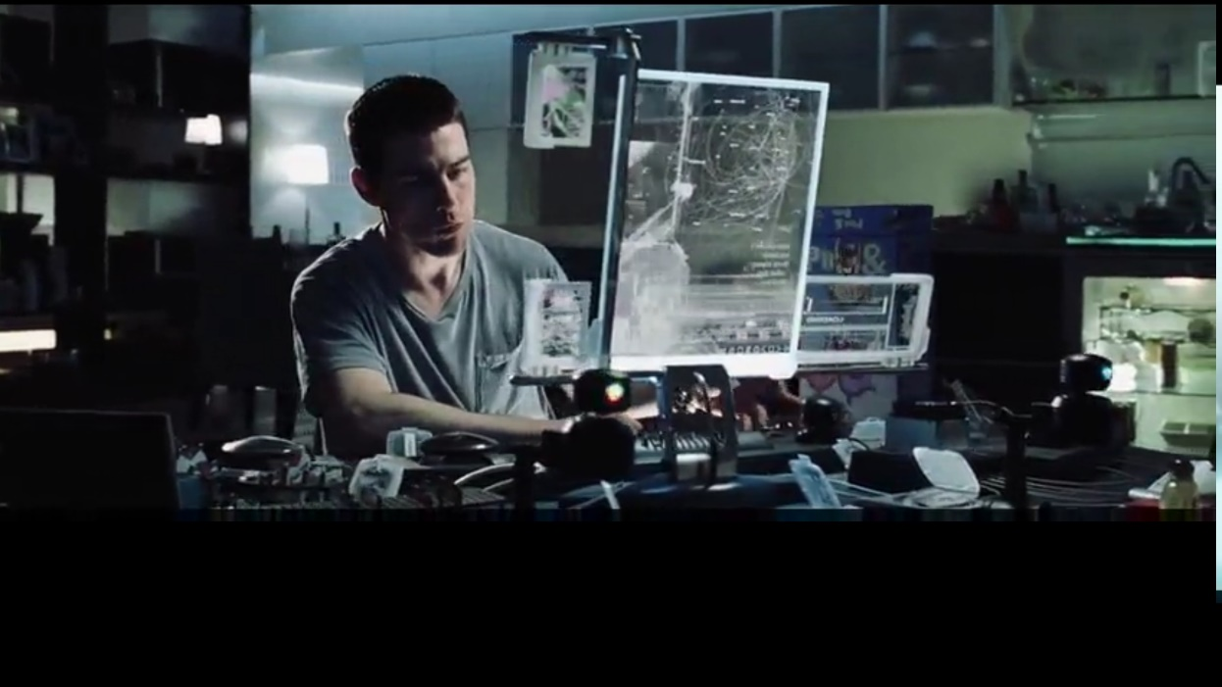
Virtual Reality

Slide 6
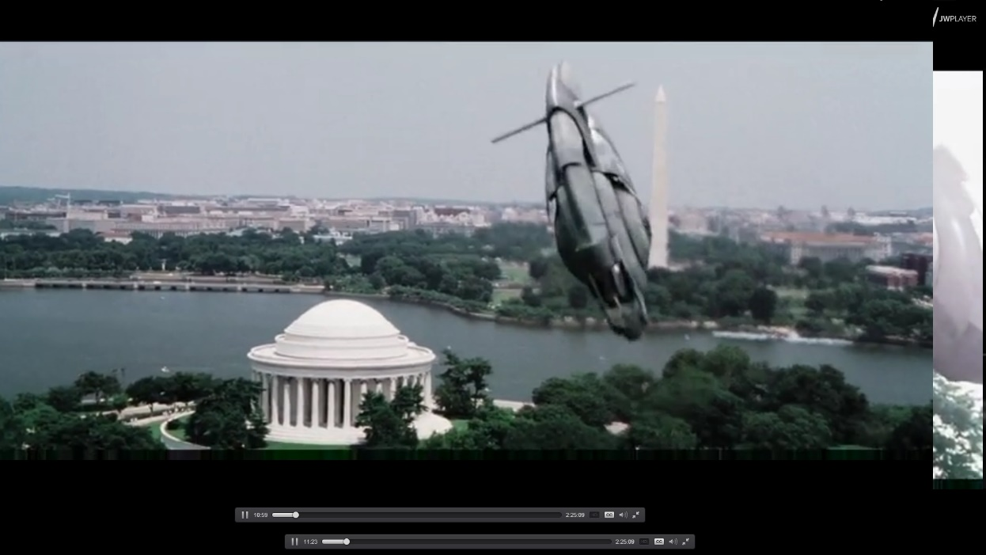
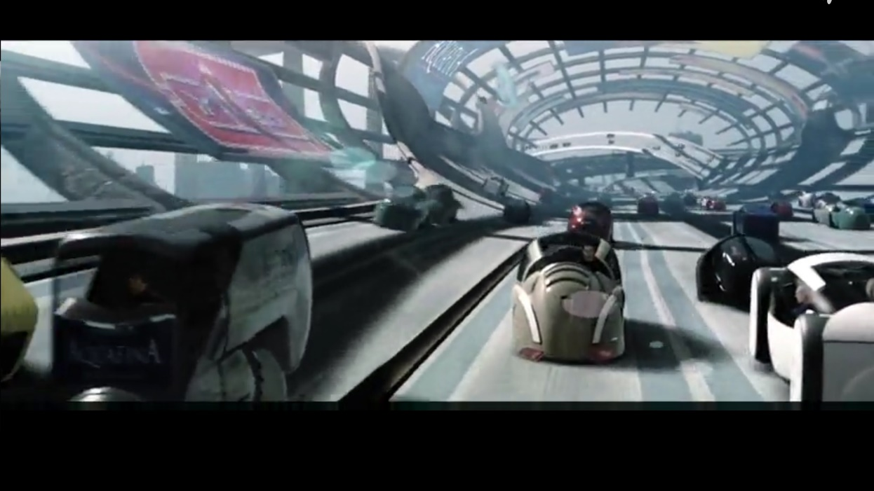
Future Vehicles

Slide 7
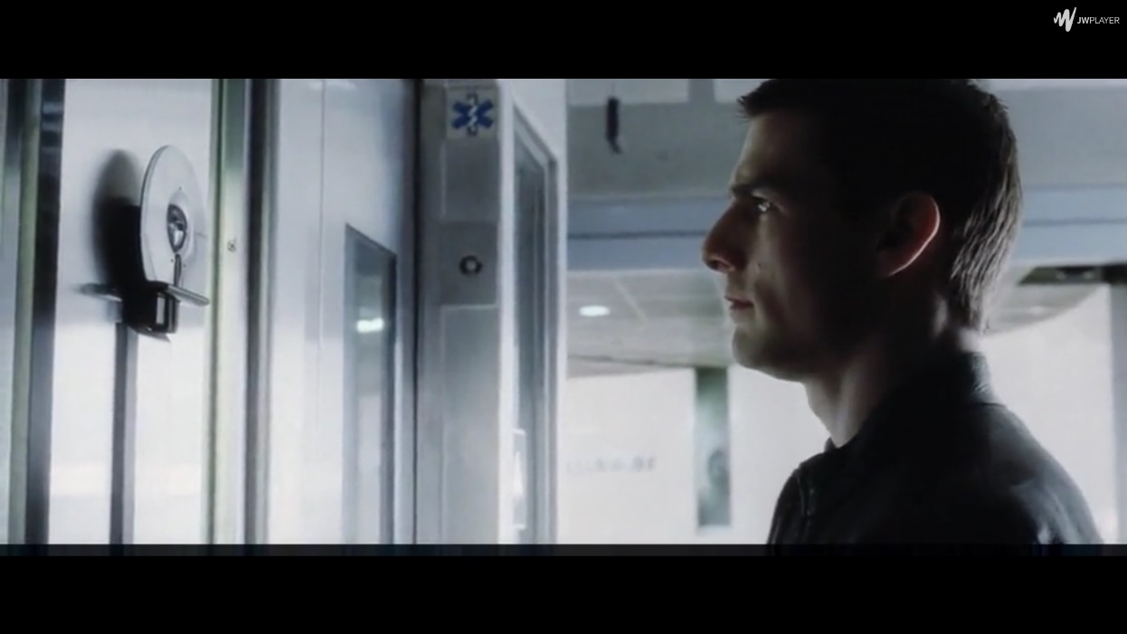
Iris Scan

Slide 8
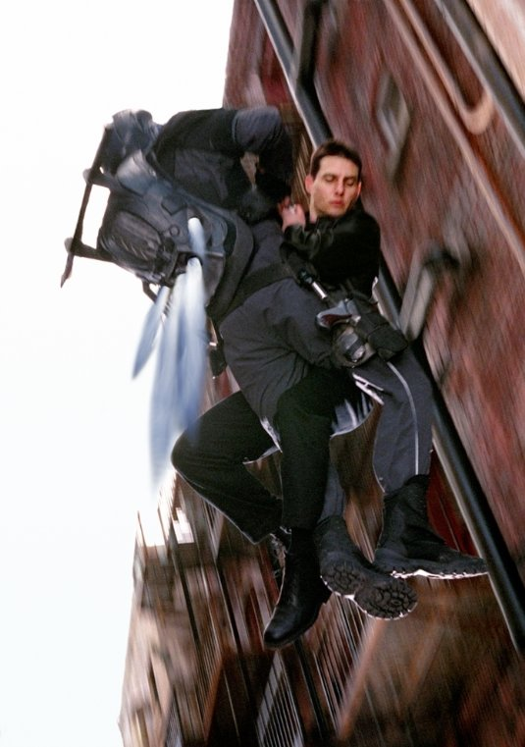
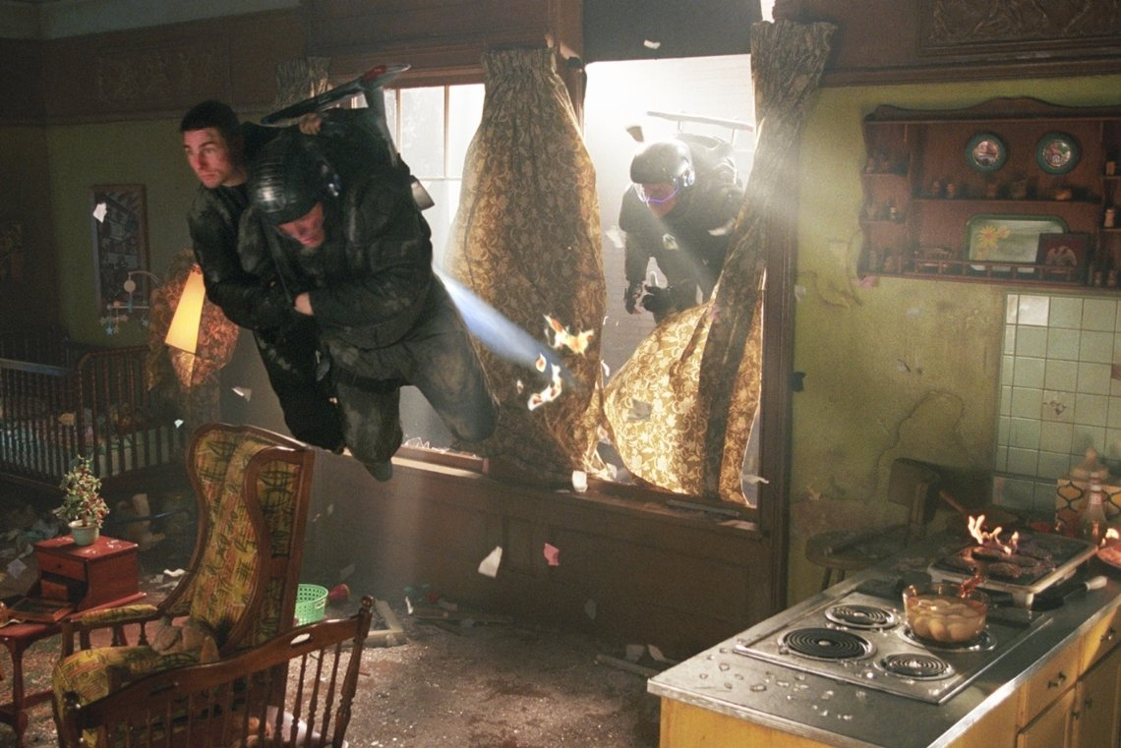
Flying Cops

Slide 9
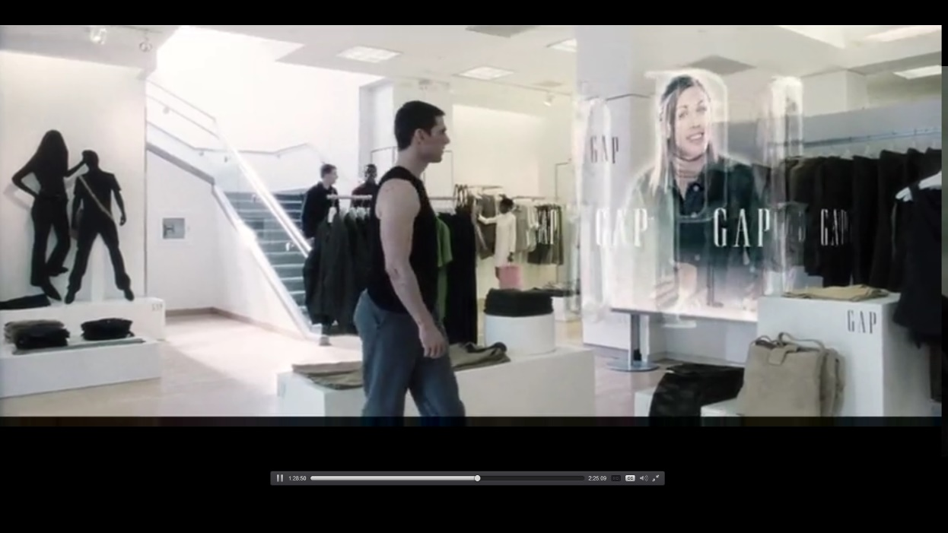
Personalized Digital Ads

Slide 10
THANK YOU!

